Slide 1
Guided Reading
“The Romance and the Reality”
(Fountas and Pinnell 2012)
Erin Wilson
Instructional Coach
AF STEM Magnet
Dr. Abodeeb
Univ. of Hartford
January 14, 2014

Slide 2
Learning Targets
I can identify the essential components of guided reading.
I can actively participate in a collaborative analysis using a nonfiction text.
I can identify the structure of guided reading.
I can explain how to scaffold during guided reading.
I can identify the teachers role and students role before, during and after guided reading.
I can apply my new learning in my planning and instruction during guided reading.

Slide 3
Let’s Get Our Read On!!!
Please transition and sit with the following groupmates:
Group 1: Hincks, *Bolton, Wright, Kanehl
Group 2: *Scopino, Frigo, Brooks
Group 3: Cleasby, Colenbaugh, *Garrott
Group 4: *Knowles, Desautels, Knight
* First Presenter
Assign Time Keeper and Facilitator

Slide 4
Collaborative Analysis
Exped. Learning: Final Word Discussion Protocol
Mentor Text: The Romance and the Reality
(Fountas and Pinnell)

Slide 5
The Big Picture
Child’s Individual Potential
ZONE OF PROXIMAL DEVELOPMENT
Child’s Assisted Potential

Slide 6
Scaffolding
Within the ZPD- the teacher’s role is to scaffold the child from his individual potential to his assisted potential.
His independent potential moves along the continuum as the child gains more competence.
The teacher continues to adjust support as needed with both verbal and textual scaffolding

Slide 7
Scaffolding in a Total Reading Program
Read Aloud: Fluency, Modeling, Crafting
Maximum Teacher Support
Shared Reading: Fluency, Modeling, Crafting
Maximum Teacher Support
Guided Reading: Individual and group ZPD with verbal scaffolding
Intermediate Teacher Support
Independent Reading: 100% Independent with conferring
Minimum Teacher Support

Slide 8
From Guided Rdg: The Romance and the Reality (Fountas and Pinnell, 2012)

Slide 9
Guided Reading within a literacy program
Guided Reading:
Is one of several kinds of reading that takes place.
Gives children the opportunity to develop as individual readers while participating in a socially supported activity.
Gives teachers the opportunity to observe readers as they process new text.
Gives readers the opportunity to develop reading strategies.
Develops the abilities for students to become independent readers.

Slide 10
Essential Components
A teacher works with a small group.
Children in the group are similar in their development of a reading process and are able to read about the same level of text.
Teachers introduce the stories and assist the children’s reading in ways that help to develop independent reading strategies.
The goal is for children to read independently and silently.
The emphasis is on reading increasingly challenging books over time.
Children are grouped and regrouped in a dynamic process that involves ongoing observation and assessment.
Fountas & Pinnell-Guided Reading, p. 4

Slide 11
Overall Purpose
TO ENABLE CHILDREN TO READ FOR MEANING AT ALL TIMES!!!!!!
To develop a network of strategies
Use three sources of language information: meaning, structure and visual information effectively. (Also know as semantic, syntactic and graphophonic cueing systems).

Slide 12
Format-Before Reading
Teacher
Selects appropriate text, that will be supportive with a few problems to solve
Prepares an introduction to the story.
Introduces the story keeping in mind language sources and the skills of the reader.
Leaves some questions to be answered during reading.
Children
Engage in conversation about the story.
Raise questions.
Build expectations.
Notice information in the text.
Fountas and Pinnell-Guided Reading p.7

Slide 13
Format-During Reading
Teacher
“Listens in”
Observes the reader’s behaviors for evidence of strategy use.
Confirms children’s problem-solving attempts and success.
Interacts with individuals to assist with problem- solving at difficulty.
Makes notes about the strategies of individual readers.
Children
Read the whole text or unified part to themselves (softly or silently.
Request help with problem solving when necessary.
Fountas and Pinnell-Guided Reading p.7

Slide 14
Format- After Reading
Teacher
Talks about the story with the students.
Invites personal response.
Returns to the text for one or two teaching opportunities such as finding evidence or discussing problem solving.
Assesses children’s understanding of what they read.
Sometimes engages the children in extending the story.
Children
Talk about the whole story.
Check predictions and react personally to the story information.
Revisit the text at points of problem solving as guided by the teacher.
May reread the story to a partner or independently.
Sometimes engage in activities that involve extending or responding

Slide 15
How Do we check Comprehension during Guided Reading?
Ask Children questions about reading.
Keep questioning brief
Make questions more like discussion
Structure questions so that children need to inference and not just recall
Ask questions that invite personal response
Have students retell all or parts of the story.
Observe children’s verbal and non-verbal responses. Ask students to point out evidence in the text.

Slide 16
How do I know if GR is successful?
When it seems as if students are using strategies effectively and moving into being independent readers.
You do not need to wait for benchmark testing when you use regular formative assessment and meet with students. Your observations and anecdotal records give you all the information you need.

Slide 17
A Framework for Literacy Learning (Ohio State Collaborative) The following are the components of a well balanced classroom literacy program:
Read Aloud- supports oral language development, listening comprehension and a model of “book language”.
Students are exposed to text above their level.
Some texts may also be used to teach specifics.
Shared Reading-The teacher involves the whole class in the reading process and can use the text to teach problem solving skills etc.
Guided Reading- Allows the teacher to take a more focused look at students individual reading, teach for strategies and monitor student improvement.

Slide 18
A Framework Continued
Independent Reading- Allows children to practice reading independently and employ strategies they have learned. Teachers may conference with individual students and use this time for formative assessment opportunities as is also the case with guided reading. *During independent reading, children can read to themselves or a partner.

Slide 19
A Framework Continued
Shared Writing- Teacher and children work together to create writing. Teacher supports students by acting as scribe.
Interactive Writing- As in shared writing, teacher and students work together but take turns as scribe.
Guided Writing/ Writing Workshop-Students write a variety of text, teacher guides process through mini-lessons and conferences.
Independent Writing-Children write own pieces.

Slide 20
Literacy Framework Support
Support for any literacy framework comes from the design of the classroom and supply of materials.
What would the classroom look like?
What do we need???
A RICH classroom library
Sentence Strips
Clip Boards
Markers Whiteboard/Easel/Chart Paper…
ETC.

Slide 21
Management
What do the other kids do- You must carefully consider what some meaningful activities might be for the other students to do independently
Work Board/ Centers
Buddy Reading
Word Study
Independent Reading
Writing
Literature Circles
Poetry Center
Computer Center
Listening Center
Others
Reader Response

Slide 22
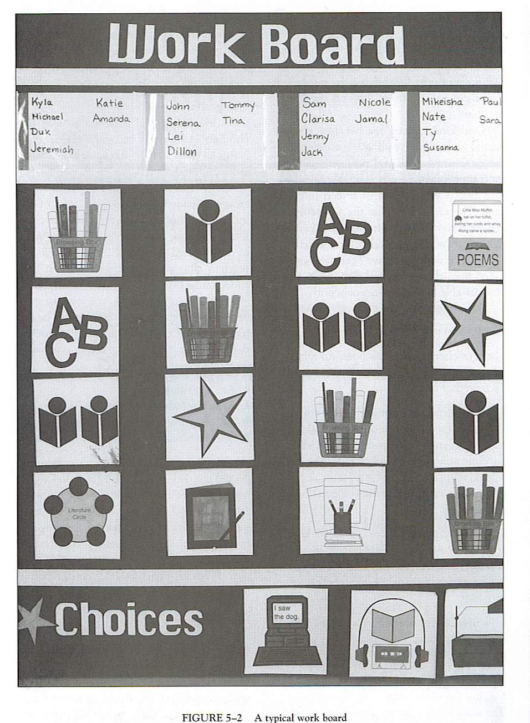

Slide 23
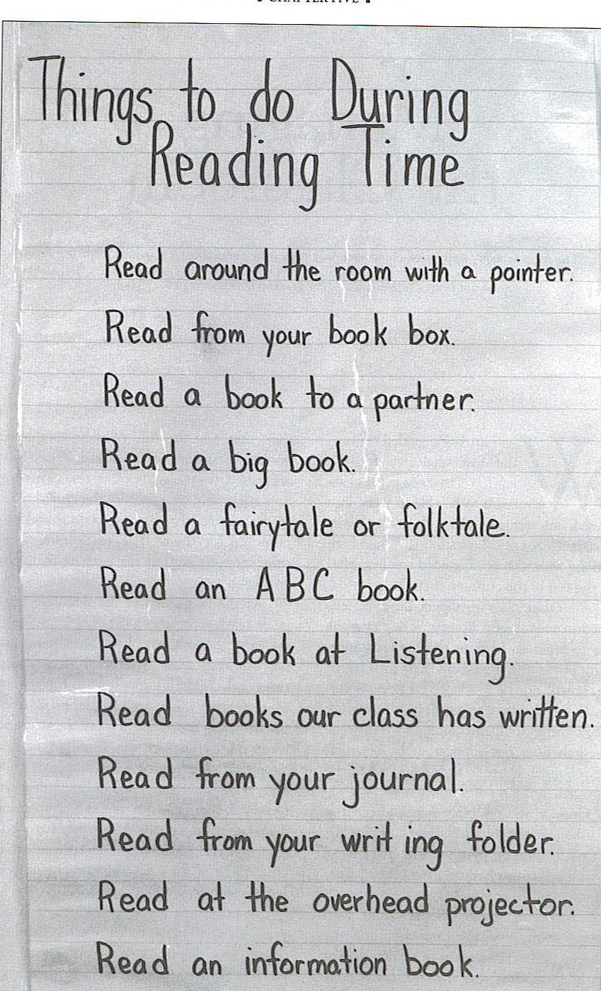

Slide 24
Dynamic Grouping
CONCERNS- Assigning students to self- contained classes or tracks within classes according to achievement or ability does not enhance achievement. Once a child is assigned to a low group, the chances of moving to a higher group is very low (Heibert 1983; Good & Marshall 1984, MRA, 1991).

Slide 25
Grouping-continued
Students in high- and low ability groups receive different instruction. For example- Allington (1983; & Allington & McGill-Franzen 1989) found that students in lower groups had few opportunities to read. They also spend more times on discreet skills such as decoding and students in higher groups spend more time on critical thinking, focus more on meaning and read two to three times more than students in low groups.

Slide 26
Traditional vs. Dynamic Grouping
Assumptions
General ability is determining factor
Progress through same phases with established rate- no change expected
One kind of grouping prevails
Assumption
Ability to use sources of info to process text is determining factor
Change on a continuous basis is expected
Different groupings for other purposes are used.

Slide 27
Traditional vs. Dynamic Grouping
Teaching
Words pre-taught
Skills practice follows reading
Limited text selections followed by workbooks and skills
Controlled vocabulary
Selections read once or twice
Round Robin Reading
Teaching
Intro foregrounds meaning and language with some attention to text.
Skills incorporated not isolated
Skills taught during reading, unlimited number of selections
Frequently used words but not controlled vocab
Selections read several times for fluency and problem solving
Focus on flexible strategy use
All students read whole text to themselves

Slide 28
Traditional vs. Dynamic Assessment of GR
Evaluation based on Progress through set group of materials and tests.
Fountas and Pinnell-Guided Reading p 101
Evaluation based on daily observation and regular, systematic individual assessment.

Slide 29
In Closing
GO, GO, MO!
Next Steps, Continued Professional Development
Please complete the Exit Slip.
Thank you for participating today!!
Hearts!!
Wilson

